Slide 1
Common Concurrency Examples
Jakob Farian Krarup (jfk@ucn.dk)

Slide 2
Common scenarios
Update an item and avoid lost update
Update an item if no one else has updated it while we were editing
Inventory check and reduction
Check for enough stock for an order – then reduce the stock
Rental, booking, enrollment
Check if item is available - then book it

Slide 3
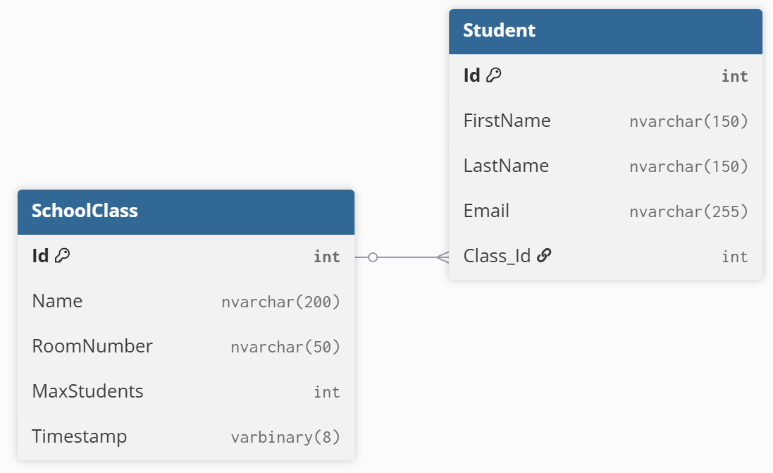
Update an item and avoid lost update
We are editing a student or a school class
Another person is editing the same object
We don’t want to overwrite their changes
These two tables are used to show two separate ways of avoiding a lost update

Slide 4
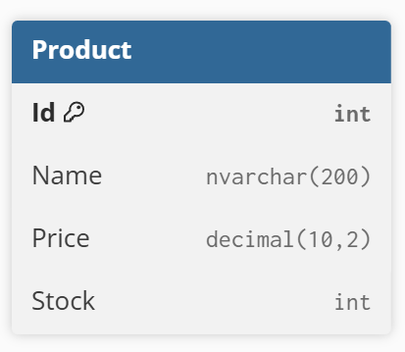
Inventory check and reduction
The previous method is insufficient, because the stock may have been changed after we checked, but there may still be enough left
Example:
Webpage retrieves stock and presents it (8 in stock)
Another user purchases 2, while we are considering the purchase
We add 5 to our basket and try to purchase (product row was changed, but we should still be able to purchase 5)

Slide 5
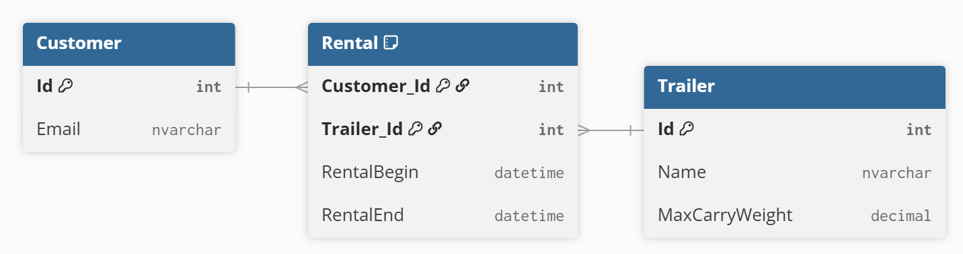
Rental, booking, enrollment
Basically any case with a many to many relationship
Consider a database for a trailer rental business:

Slide 6
Rental, booking, enrollment
When creating a rental, two things need to happen:
Check for availability
If still available, rent it
But what if two threads are running at the same time?
Thread 2
Thread 1
CheckAvailability()
CreateRental()
☑
☑
CheckAvailability()
CreateRental()
☑
☑

Slide 7
Optimistic concurrency solution
Have both insertion of rental AND check for overlapping rentals in same SQL statement
INSERT INTO Rental (Customer_Id, Trailer_Id, RentalBegin, RentalEnd)
SELECT @CustomerId, @TrailerId, @RentalBegin, @RentalEnd
WHERE NOT EXISTS (
SELECT 1
FROM Rental
WHERE Trailer_Id = @TrailerId
AND NOT (@RentalEnd <= RentalBegin OR @RentalBegin >= RentalEnd)
);";

Slide 8
Pessimistic concurrency solution
Begin a transaction with isolation level serializable
Check for availability
Insert rental/booking/membership/etc

Slide 9
Pessimistic concurrency solution
Begin a transaction with isolation level serializable
using (var transaction = connection.BeginTransaction(IsolationLevel.Serializable)) {
...
}

Slide 10
Pessimistic concurrency solution
Check for availability
SELECT COUNT(*)
FROM Rental
WHERE Trailer_Id = @TrailerId
AND NOT (@RentalEnd <= RentalBegin OR @RentalBegin >= RentalEnd);"

Slide 11
Pessimistic concurrency solution
Insert rental/booking/membership/etc
INSERT INTO Rental (Customer_Id, Trailer_Id, RentalBegin, RentalEnd)
VALUES (@CustomerId, @TrailerId, @RentalBegin, @RentalEnd);

